Slide 1


Artificial Intelligence (Machine Learning & Deep Learning)
NAVTCC & Strings Technologies
by Salman Ahmad

Slide 2
Outline
Day 1 Recap
1
2
Introduction to Python
Values, expressions and statements
3
4
String operations
Input and type casting
5
6
Comments
7
Questions
6

Slide 3
What is Python?

Slide 4

IT’S A SNAKE

Slide 5
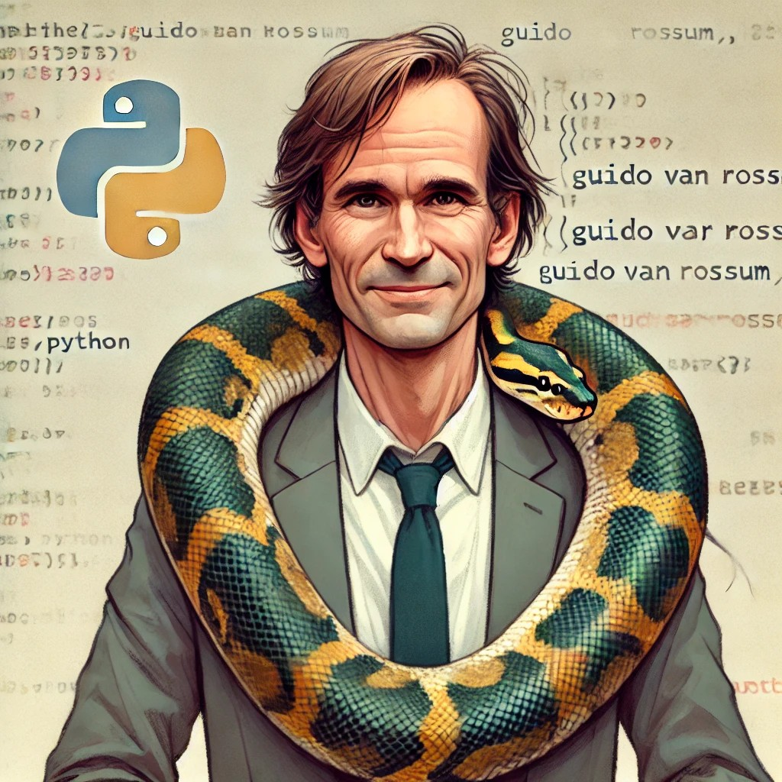
Guido van Rossum
creator of Python, the programming language
1991
Dutch programmer
Python - hobby' programming project for Unix/C hackers
“Monty Python's Flying Circus” - a BBC comedy show in 1970s

Slide 6
Why Python?
1
Easy to learn
Highly versatile
3
Huge community
2
Simple syntax
Do more with less code
Dynamic typing
Web dev
Data science and AI
Automation scripting
Game dev
Cyber security
IoT and Cloud
Desktop apps
Active and large community
More community, more support
Many frameworks and libraries
Free resources
4
High demand
high demand of people with Python skill in various industries
5
Automation
Data ETL
Reports
Workflow automation
DevOps & MLOps

Slide 7
Easy to read code
Suppression of non-mandatory delimiters
Python uses indentation to define scope
Dynamic typed, and dynamic memory usage (Both memory allocation and garbage collection).
Python is an interpreted language
Python can be run on interactive consoles (Jupyter notebook, IPython)
Python works on different platforms (Windows, Mac, Linux, Raspberry Pi, etc)
Python has a simple syntax similar to the English language and allows developers to write programs with fewer lines.
Properties of Python

Slide 8
Let’s say “Hello World!” in Python

Slide 9
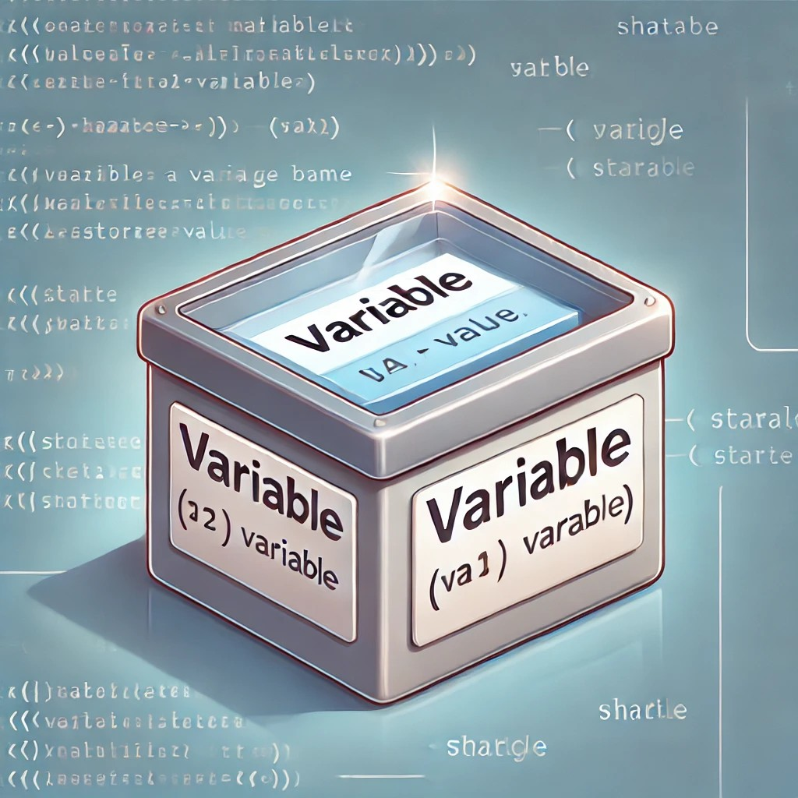
What is a “variable”?
a container in the main memory
stores data
created the moment you first assign a value to it (in Interpreter languages)
variables in Python are dynamic typed
no need to specify data type
data type according to the value stored or casted to

Slide 10
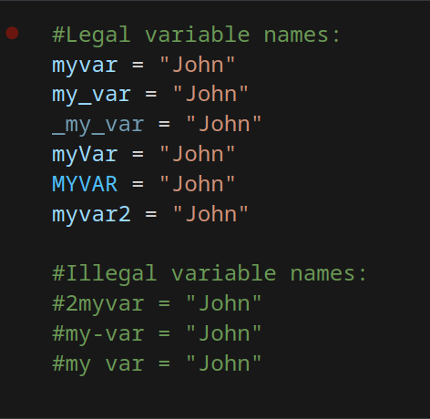
Naming Rules
Variable name must start with a letter or the underscore character
Variable name cannot start with a number
Variable name can only contain alpha-numeric characters and underscores (A-z,0-9,_)
Variable names are case-sensitive

Slide 11
value
Variable – A container
Array – A sequence of variables
value
value
value
value
value
...
...
0
1
2
3
n
index

Slide 12
Values and Expressions
What are expressions?
Combination of values, variables and operators
Expressions always return a result
Examples:
- 5 + 3 → returns 8
- ‘Hello’ + ‘World’ → returns ‘HelloWorld’
- 10 > 9 → returns True

Slide 13
Values and Expressions
What are Values?
Values are basic pieces of data that Python can work with
Examples
- Numeric: 5, 3.14
- String: ‘Hello’, “World”
- Boolean: True, False

Slide 14
Built-in Data Types
Text Type:----- str
Numeric Types:----- int, float, complex
Sequence Types:----- list, tuple, range
Mapping Type:----- dict
Set Types:----- set, frozenset
Boolean Type:----- bool
Binary Types:----- bytes, bytearray, memoryview

Slide 15
Values and Expressions
What are expressions?
Combination of values, variables and operators
Expressions always return a result
Examples:
- 5 + 3 → returns 8
- ‘Hello’ + ‘World’ → returns ‘HelloWorld’
- 10 > 9 → returns True

Slide 16
Operators
Arithmetic
+ (addition)
- (subtraction)
* (multiplication)
/ (division)
% (modulus)
** (exponentiation)
// (floor division)
Comparison
== (equality check)
< (less than)
> (greater than)
<= (less than or equal)
>= (greater than or equal)
!= (not equal)
Logical
and
or
not
Identity operator
is – returns True if both variables are the same
not – returns True if both variables are not the same

Slide 17
Operators
Assignment Operators
Operator Example Equivalent To
= x = 5
+= x += 5 x = x + 5
-= x -= 3 x = x - 3
*= x *= 2 x = x * 2
/= x /= 4 x = x / 4
%= x %= 3 x = x % 3
**= x **= 2 x = x ** 2
//= x //= 3 x = x // 3
?
Why use compound assignment operators?
- cleaner and shorter code
- common in loops and data processing

Slide 18
Operators
Bitwise Operators
Operators that work at the bit level
Used for binary operations
Low level programming, optimizing and device control
0011
1100

Slide 19
Operators
Bitwise Operators
a = 5, b = 3
Operator Desciption Example Result
& Bitwise AND a & b 1
| Bitwise OR a | b 7
^ Exclusive OR a ^ b 6
~ Bitwise NOT ~a -6 (two’s compliment; ~n = - (n + 1))
<< Left shift a << 1 10
>> Right shift a >> 1 2

Slide 20
Let’s write some code

Slide 21
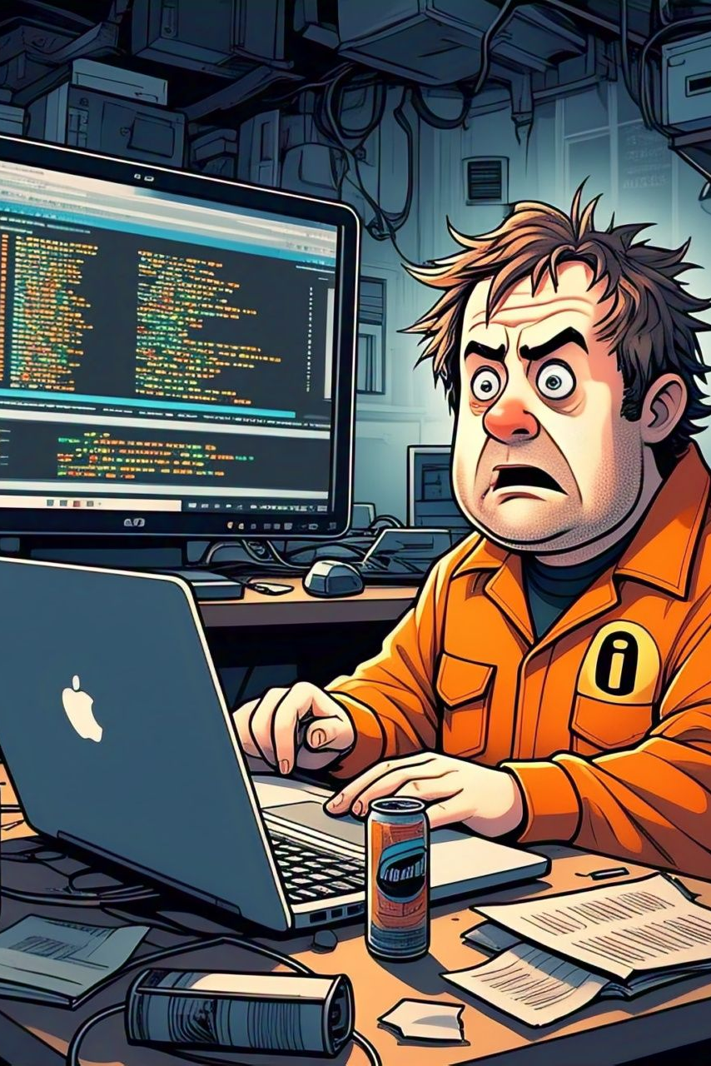
Questions?
"He who asks a question is a fool for a minute; he who does not remains a fool forever." – Confucius

